Slide 1
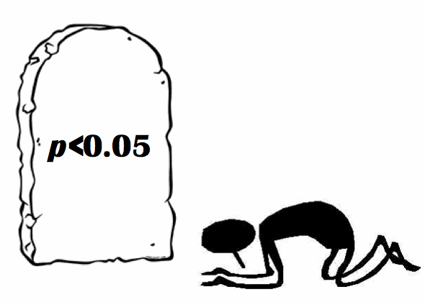
P-values & reliability of estimates
Block Course Zoology and Evolutionary Biology FS18
Julia Fanderl Raphael von Büren Supervised by: Valentin Amrhein Tobias Roth

Slide 2
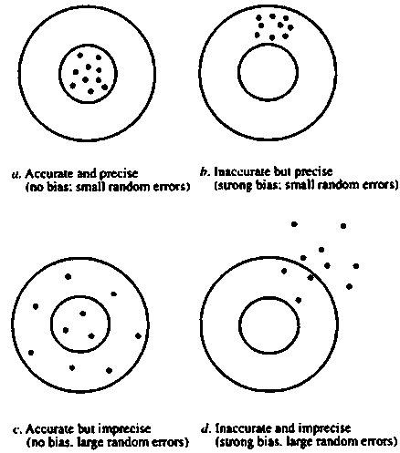
Reliability ≈ Precision (Cohen 1988) (if there is no bias)
“The closeness with which [a point estimate] can be expected to approximate the relevant population value.”
Cohen (1988)
high reliability
low reliability
Confidence interval

Slide 3
P-value
Probability of the observed data, or data more extreme, given that the null hypothesis is true.
P-value mixes…
... effect size
... reliability of point estimate

Slide 4
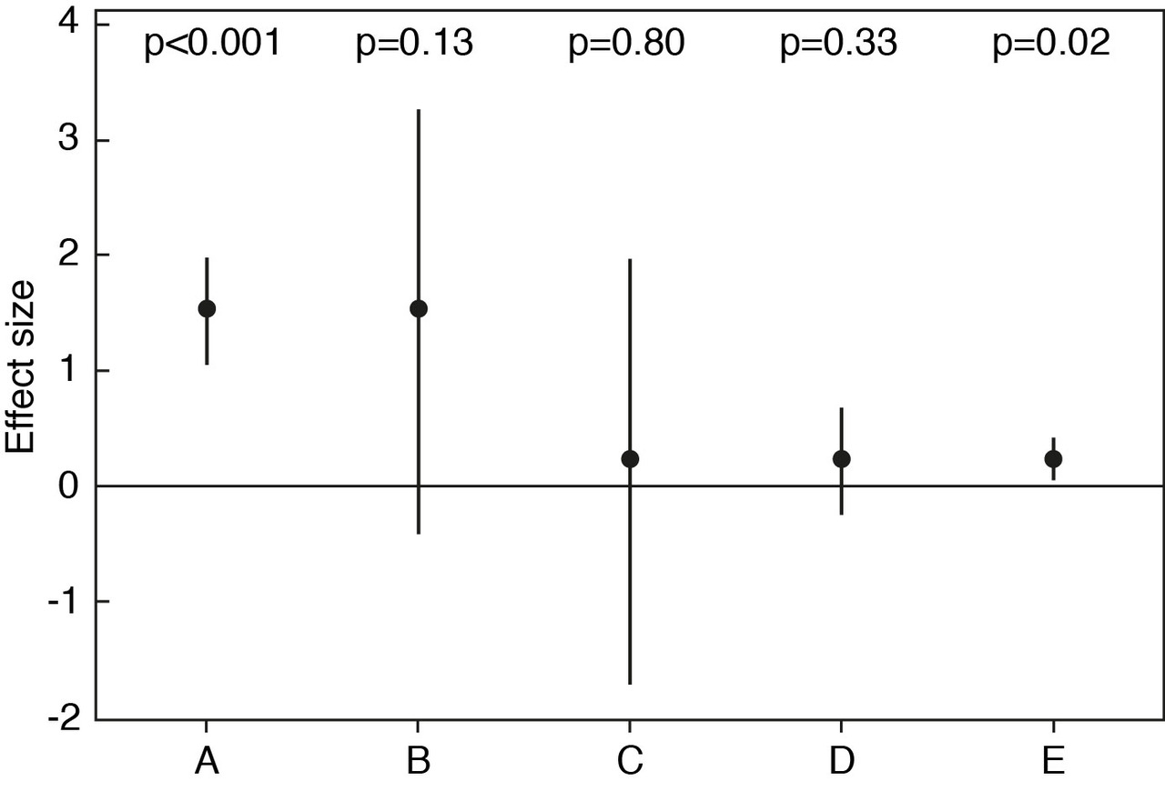
P-value mix
Amrhein, Korner-Nievergelt & Roth (2017)

Slide 5
Study question
Do p-values mislead about reliability of point estimates?

Slide 6



Workflow

Slide 7
Questionnaire
Randomized
5 boxplots
5 confidence intervals
5 boxplots
5 confidence intervals
P-value presented
No P-value presented

Slide 8
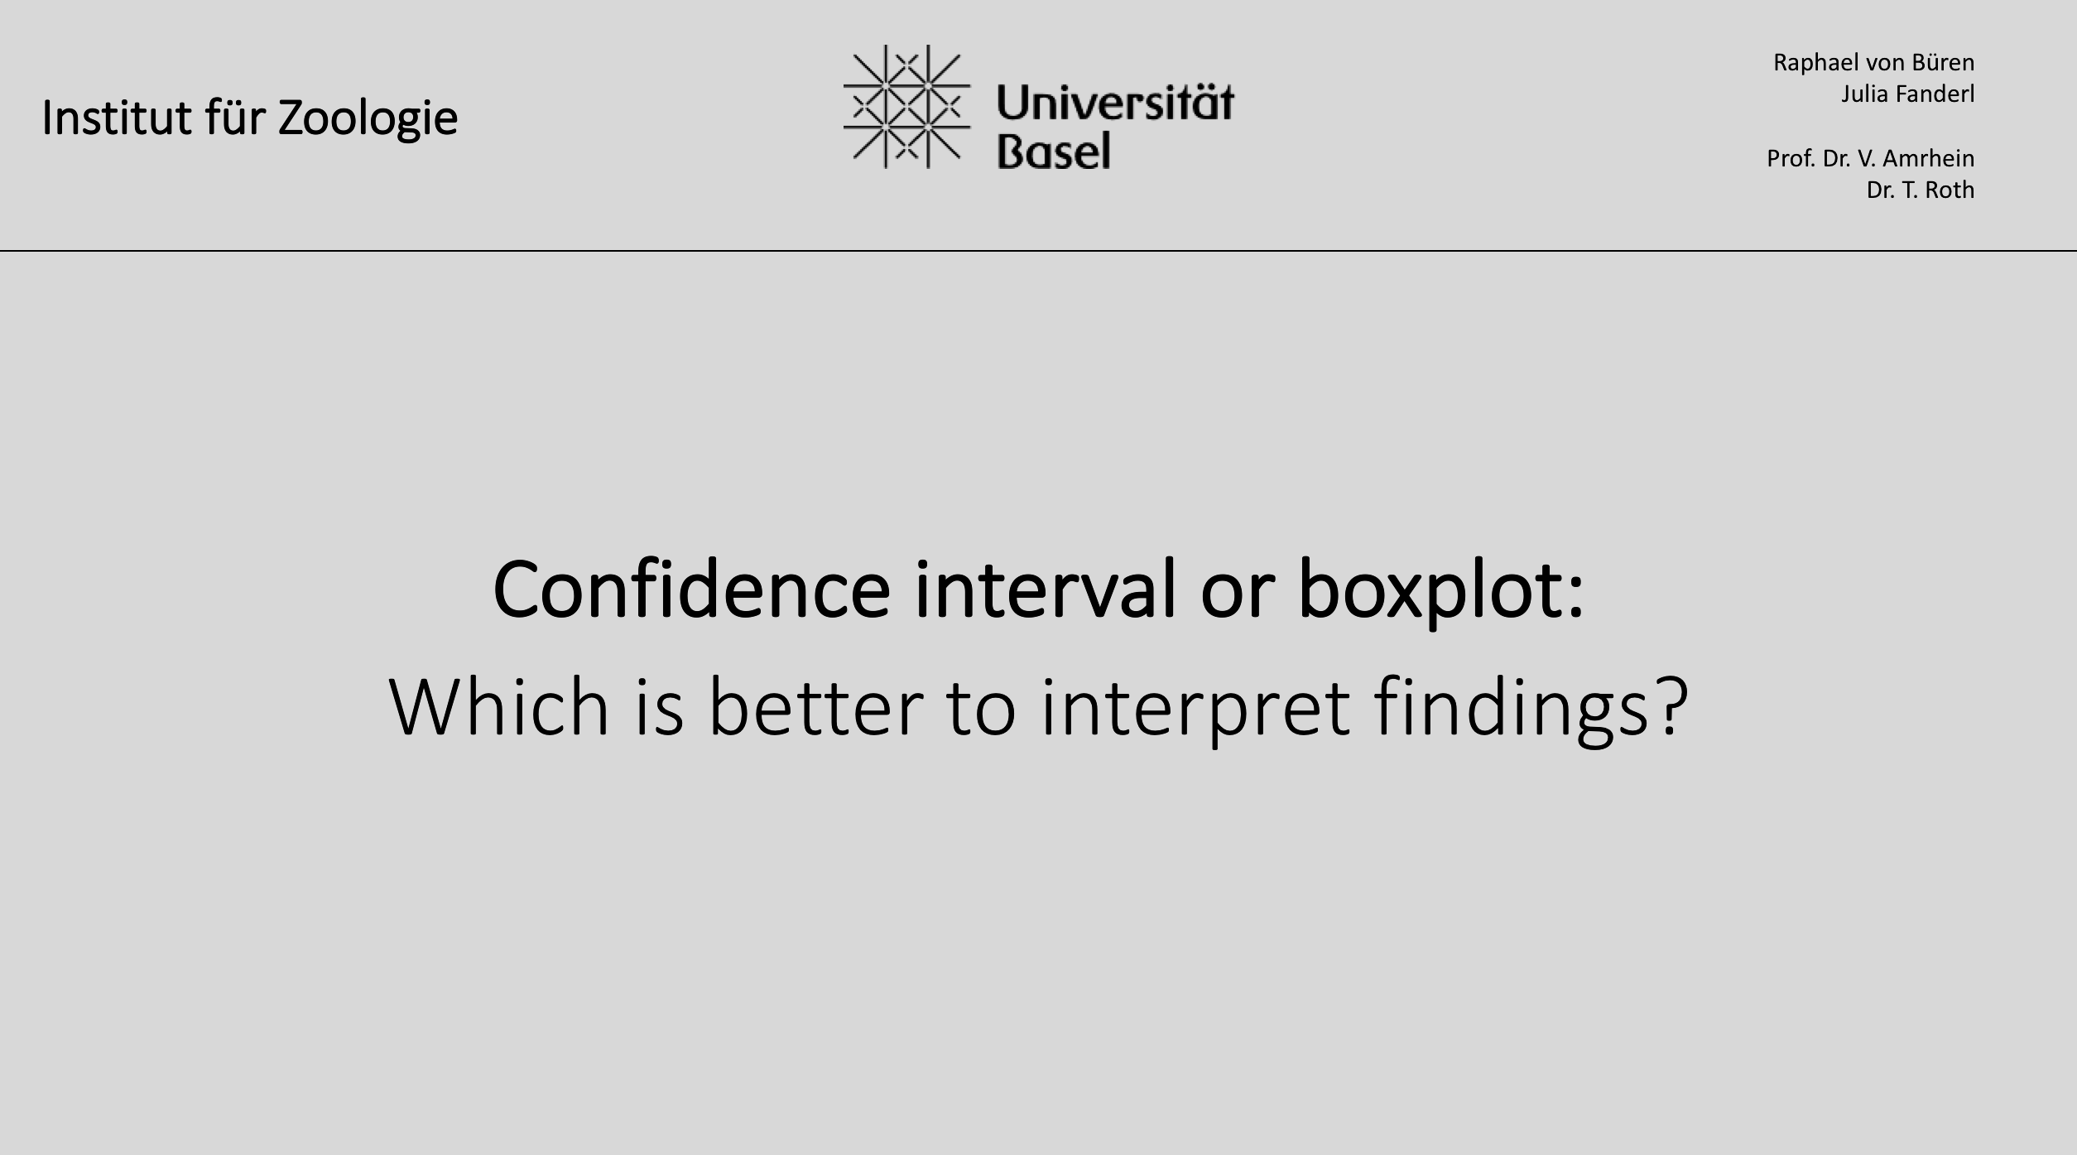
Questionnaire

Slide 9
Questionnaire
Which of the estimates is more reliable?

Slide 10
Questionnaire
Which of the estimates is more reliable?

Slide 11
Questionnaire
Which of the estimates is more reliable?

Slide 12
Questionnaire
Which of the estimates is more reliable?

Slide 13
Questionnaire

Slide 14
Questionnaire

Slide 15
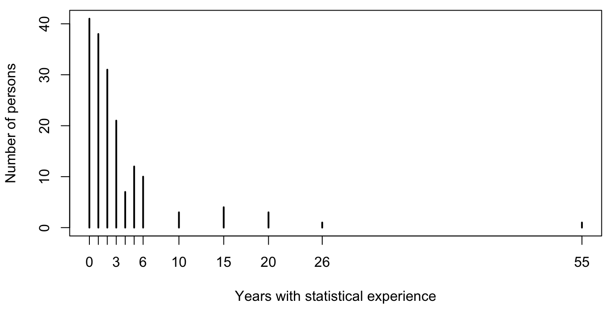
Sample
172 persons
44% women
67% correct answers

Slide 16
Logistic regression
 | Estimate | Std. Error | p-value
Intercept | 0.268 | 0.321 | 0.403
Statistical experience | 1.247 | 0.238 | 0.000
Treatment | 0.341 | 0.381 | 0.372
Observer | -0.113 | 0.243 | 0.643
Gender | -0.203 | 0.246 | 0.409
Treatment x Experience | -0.971 | 0.314 | 0.002

Slide 17
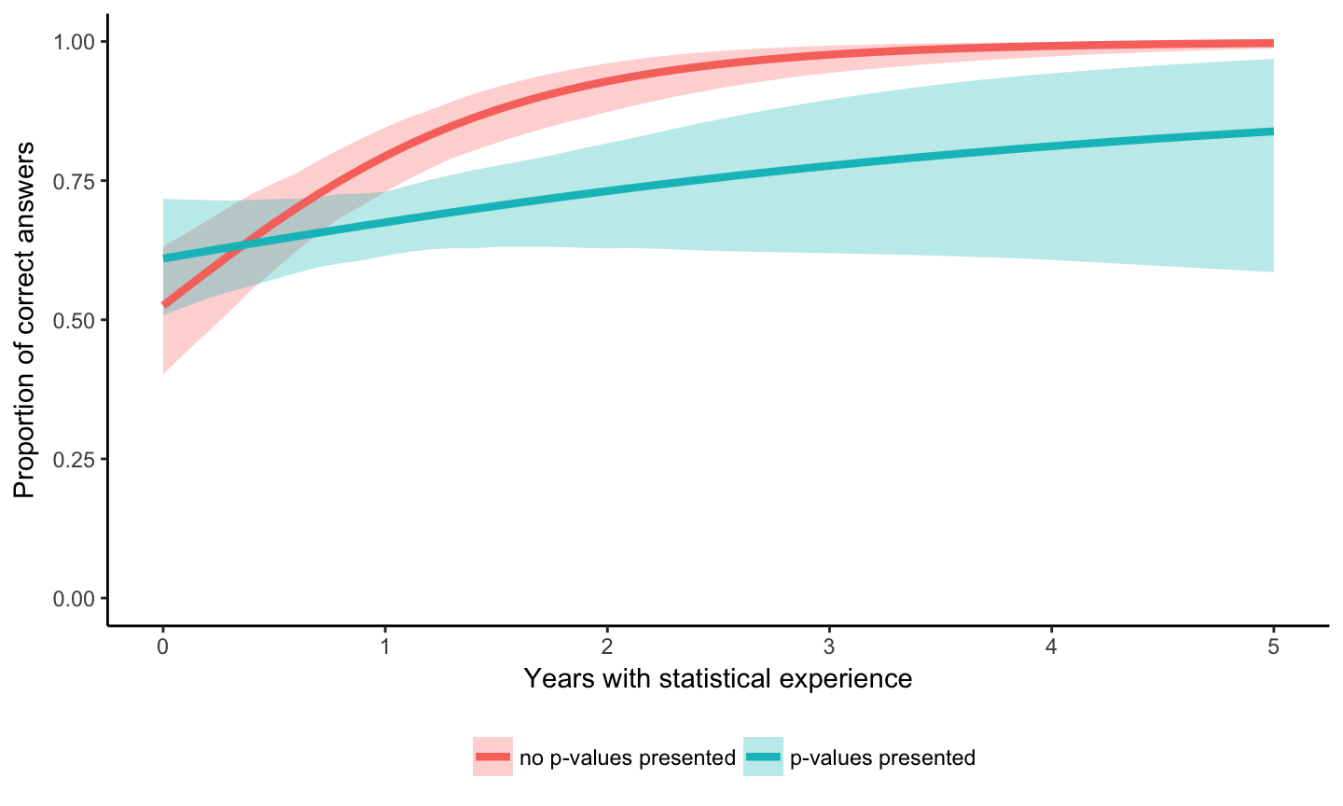
Misleading by p-values
1.00
0.75
0.50
0.25
0.00
0
1
2
3
4
5

Slide 18
Misleading by p-values – and now?
To describe…
… evidence against a null hypothesis
… reliability of a point estimate
P-value
Confidence interval
Effect size
Reliability

Slide 19
Misleading by p-values – and now?
p-values seem to mislead about reliability of estimates
Mix of information
P-value
Effect size
Reliability

Slide 20
Thank you!

Slide 22

Acknowledgement
Tobias Roth
Valentin Amrhein

Slide 23
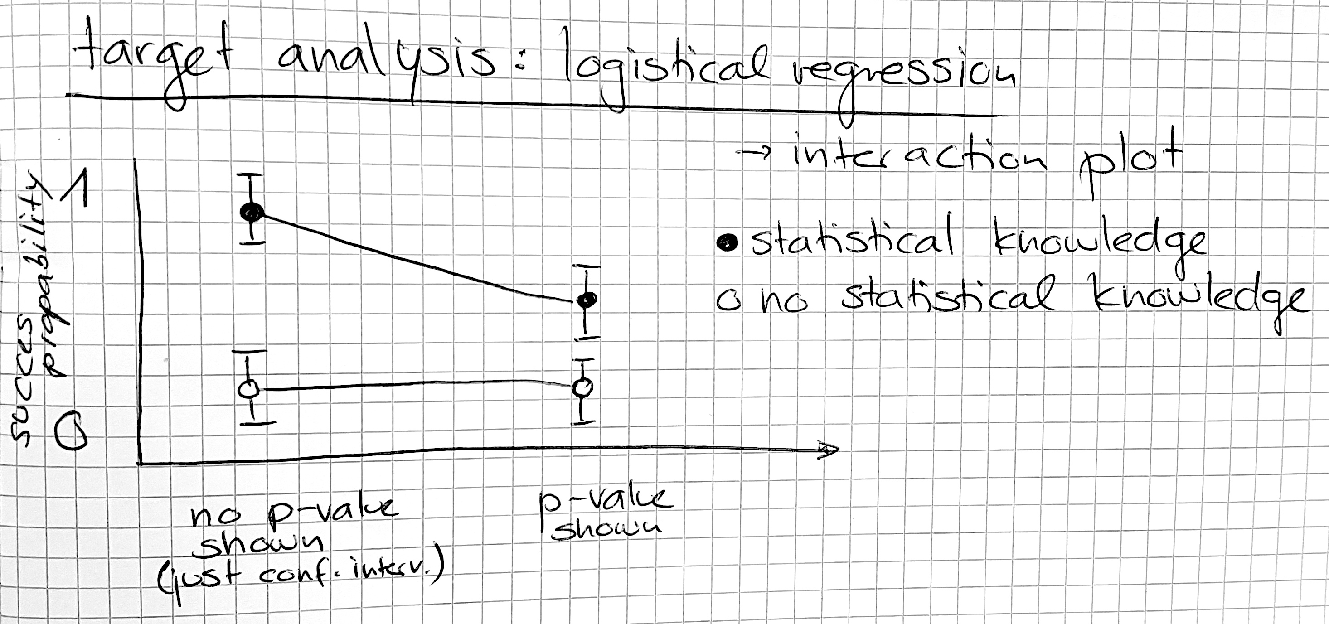
Appendix - Hypothesis
Lab Journal, Raphael von Büren, p.6

Slide 24
Appendix

Slide 25
Appendix
“It seems to me that statistics is often sold as a sort of alchemy that transmutes randomness into certainty, an ‘uncertainty laundering’ that begins with data and concludes with success as measured by statistical significance.
(…)
The solution is not to reform p-values or to replace them with some other statistical summary or threshold, but rather to move toward a greater acceptance of uncertainty and embracing of variation.”
Gelman (2016)

Slide 26
Appendix

Slide 27
Appendix

Slide 28
Appendix

Slide 29
Appendix

Slide 30
Appendix

Slide 31
Appendix

Slide 32
Appendix

Slide 33
Appendix

Slide 34
Appendix

Slide 35
Appendix

Slide 36
Appendix

Slide 37
Appendix

Slide 38
Appendix

Slide 39

Raphael von Büren
Julia Fanderl
Prof. Dr. V. Amrhein
Dr. T. Roth
Institut für Zoologie
Confidence interval or boxplot:
Which is better to interpret findings?

Slide 40
Average
Confidence interval

Slide 41
Median
Boxplot

Slide 42
The average / median in our sample is an estimate of the true average / median in a larger population

Slide 43
Which of the estimates on each slide is more reliable?
(The two p-values refer to one-sample t-tests against the same null hypothesis;
sample sizes are equal)

Slide 44
You will see 10 slides. 5x Confidence intervals, 5x boxplots.
For each slide, you have 6 seconds to answer…
Examples
p = 0.XX p = 0.XX
Is the left or right estimate more reliable?

Slide 45
You will see 10 slides. 5x Confidence intervals, 5x boxplots.
For each slide, you have 6 seconds to answer…
Examples
p = 0.XX p = 0.XX
Is the left or right estimate more reliable?
No idea? Please just guess. We need an answer, but it does not need to be correct…

Slide 46
Let’s start...!

Slide 48
1

Slide 50
2

Slide 52
3

Slide 54
4

Slide 56
5

Slide 58
6

Slide 60
7

Slide 62
8

Slide 64
9

Slide 66
10

Slide 68
Thank you !

